Slide 1
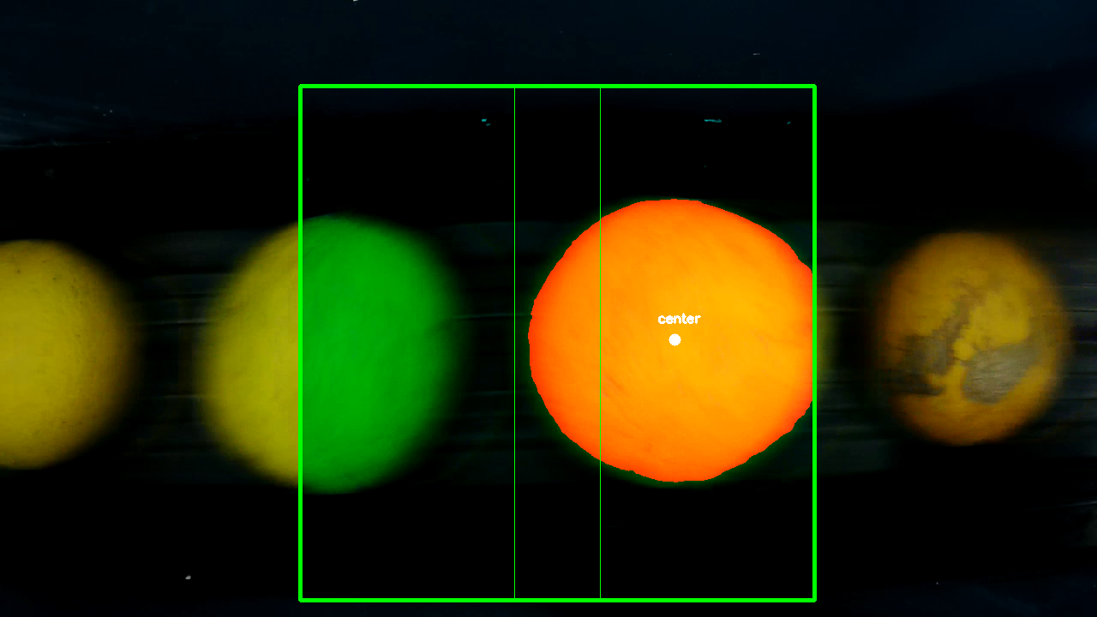
Direction
PC Segmentation
ROI
Snapshot Threshold

